Slide 1




PDS
AWS SES (Simple Email Service)
Computer Vision
https://github.com/siagianp
https://www.youtube.com/@AmelOline/videos
https://github.com/amelcharolinesgn2/Cloud-Infrastructures
https://github.com/amelcharolinesgn2/ClouD-Infrastructure-SISKA-2025
https://github.com/amelcharolinesgn2/CCNA1
https://github.com/amelcharolinesgn2/CCNA2
https://github.com/amelcharolinesgn2/AWS Certificate
Notes:
Lab Session 01: AWS Compute Foundations – EC2, Networking, and Application Deployment Lab Session 02: Identity and Access Control with IAM Lab Session 03: Cloud Storage Solutions – S3, EBS, and EFS Lab Session 04: Database Services – RDS, DynamoDB, and ElastiCache Lab Session 05: Load Balancing and Auto Scaling Lab Session 06: Container Orchestration with ECS, Fargate, and EKS Lab Session 07: Serverless Computing with Lambda Lab Session 08: Monitoring, Logging, and Security Auditing Lab Session 09: Infrastructure as Code – CloudFormation, CDK, and Terraform Lab Session 10: CI/CD Pipelines – App Runner, CodePipeline, GitHub Actions, and CodeDeploy Lab Session 11: AI/ML Services – Rekognition, Comprehend, Translate, and SageMaker Lab Session 12: Hybrid Cloud Networking – VPC Peering, Transit Gateway, VPN, and Direct Connect Lab Session 13: Security and Compliance – AWS Config, GuardDuty, Security Hub, and KMS Lab Session 14: Disaster Recovery and Business Continuity – AWS Backup, Multi-Region, and Failover Lab Session 15: Migration and Modernization – DataSync, DMS, MGN, Containers, and Serverless
Lab Session 16: Cost Management and Optimization – Cost Explorer, Trusted Advisor, Budgets, and Well-Architected
https://www.youtube.com/watch?v=SOTamWNgDKc&t=19604s

Slide 2
AWS SES (Simple Email Service)
Email Sending Simplified with AWS

Slide 3
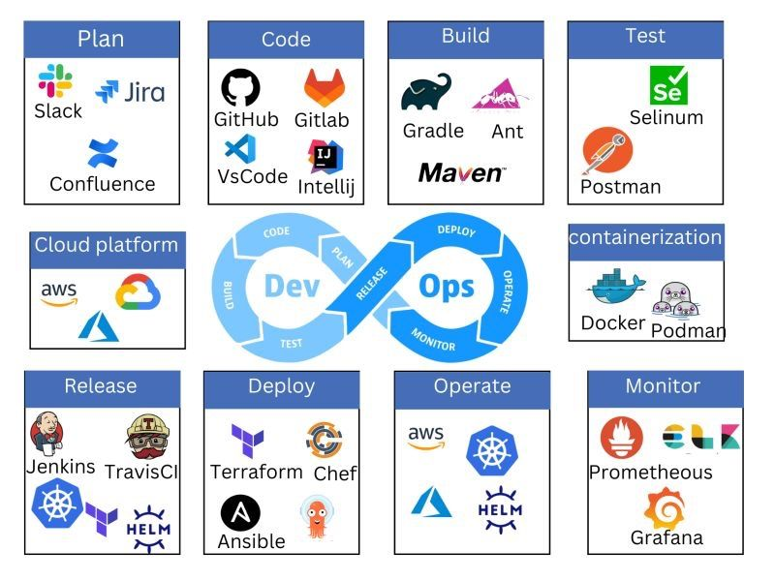

Slide 4
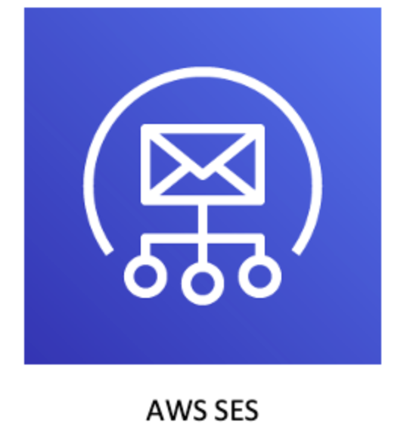
What is Amazon SES?
A cloud-based email sending service for sending transactional and marketing emails.
Features:
High deliverability
Scalable
Reliable
Use Cases:
Notifications
Marketing campaigns
Transactional emails (e.g., OTPs)

Slide 5
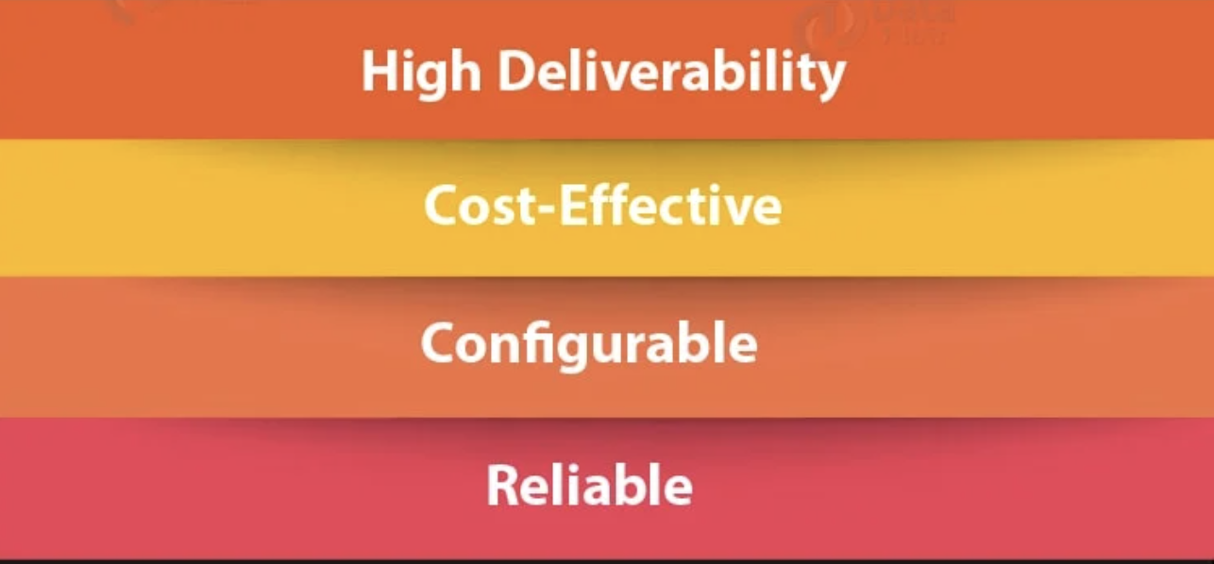
Key Features of Amazon SES
Highly scalable and cost-effective.
Support for bulk and transactional emails.
Built-in analytics (open, click-through, and bounce rates).
Integration with other AWS services like Lambda and SNS.

Slide 6
How Amazon SES Works
Basic flow: Verify domain/email → Create SMTP credentials → Send email.
Identity types: Domain vs. Email Address.
Authentication methods: SPF, DKIM, and DMARC.
DKIM ensures that an email has not been altered in transit and verifies the sender's authenticity by attaching a cryptographic signature.
SPF allows the domain owner to specify which mail servers are authorized to send emails on behalf of their domain.
DMARC (Domain-based Message Authentication, Reporting, and Conformance) is an email authentication protocol designed to protect your domain from spoofing and phishing attacks. It builds on SPF and DKIM to provide a policy framework for email authentication and reporting.

Slide 7
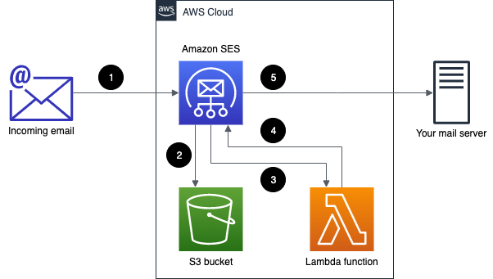
Sending Emails with AWS SES
Sending emails via SMTP Interface.
Using AWS SDKs (e.g., Boto3 for Python).
Limits and quotas.

Slide 8
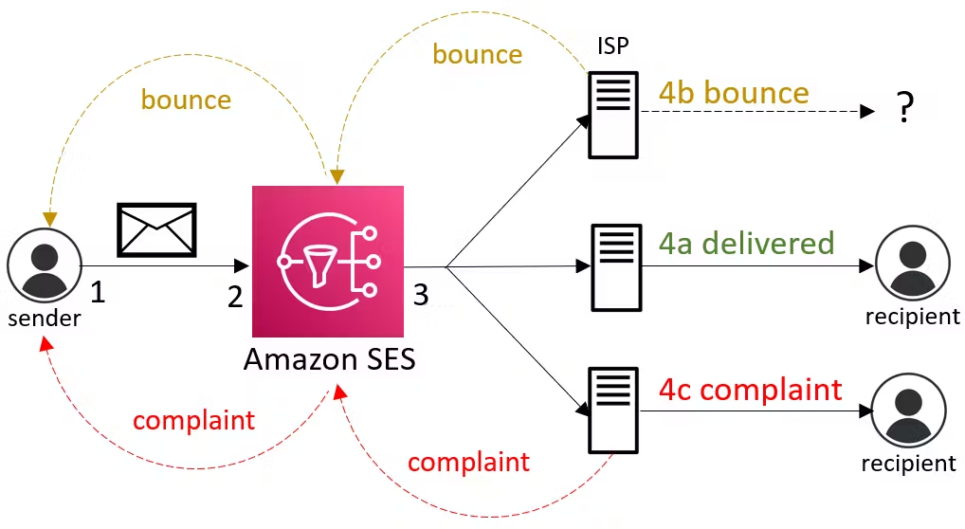

Slide 9
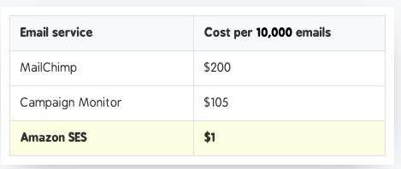
SES Pricing
Emails sent: $0.10 per 1,000 emails
Attachments: Cost for data transfer applies
Free Tier: 62,000 emails per month when sent from an EC2 instance

Slide 10

SES Best Practices
Use DKIM and SPF for email authentication.
Monitor bounce and complaint rates.
Regularly review email metrics.
Using IAM for access control.

Slide 11
Question: Sending Bulk Emails to Customers
You have an e-commerce website and need to send order confirmation emails to thousands of customers every day. You’ve decided to use AWS SES for this purpose.
What steps would you take to configure SES to handle these bulk emails effectively?
How would you ensure that your emails are successfully delivered and avoid being marked as spam?
How would you monitor and handle bounce rates or complaints using AWS SES?

Slide 12
Steps to handle these bulk emails effectively
Setup Sender Identity
Request Production Access
Use IAM for Access Control
Manage Quotas and Limits
Configure Sending
Leverage SNS for Feedback
Monitor Performance

Slide 13
It is never too late to be what you might have bees
by: Amel and Irene

Slide 14
THANK YOU
Amel charoline
Amel Online & Irene magdalena
https://github.com/siagianp
https://www.youtube.com/@AmelOline/videos
https://github.com/amelcharolinesgn2/Cloud-Infrastructures
https://github.com/amelcharolinesgn2/ClouD-Infrastructure-SISKA-2025
https://github.com/amelcharolinesgn2/CCNA1
https://github.com/amelcharolinesgn2/CCNA2
https://github.com/amelcharolinesgn2/AWS Certificate

